Slide 1
What Matters to Americans: Social, Economic and Political Values
The Anatomy of Civil Societies Research Project Team

Slide 2
The Anatomy of Civil Societies Research Project
Consumer Social Responsibility
Individual Social Responsibility
Workers
Investors
Boards/TMT
The Anatomy of Civil Societies
Research Project

Slide 3
The Anatomy of Civil Societies Research Project
Consumer Social Responsibility
T. Devinney & P. Auger
Individual Social Responsibility
G. Dowling, C. Eckert, R. Belk,
G. Eckhardt, P. Burke, J. Louviere
M. Ulrych, V. Laoledchai
R. DeSailly, M. Ulrych,
G. Murphy, V. Laoledchai,
A. Early, C. Erfgen
R. Belk, C. Eckert,
J. Schwalbach, H. Sattler
The Anatomy of Civil Societies
Research Project

Slide 4
Project Overview
Multiple societies
Australia, USA, UK, Germany
Czech Republic, Argentina, Hong Kong, India
Pictures of complete representative populations
Comparable socio-demographic, political, personality and religious measures (focus on actions) within and across societies
Investigation of interactions with Civil Society Organizations (CSOs)
Multiple measures of economic, social and political issue salience by:
Category (16 in total)
Single issues (113 in total)
That account for:
Realistic trade-offs rather than costless characterizations

Slide 5
Project Overview
Continuing investigations of CSO supporters
Work with specific CSOs at the “micro” level
WWF, Greenpeace, Amnesty International and Médecins Sans Frontières
Matching samples of supporters on
Social, economic and political profiles
Personality and demographics
Utilizing multiple methods of investigation
Social preference profiling
Personality measurement
Ethnographies
Economic & behavioral experimentation
All aimed at providing a comprehensive
“anatomy” of CSO supporters within the contexts of
the societies in which they exist

Slide 6
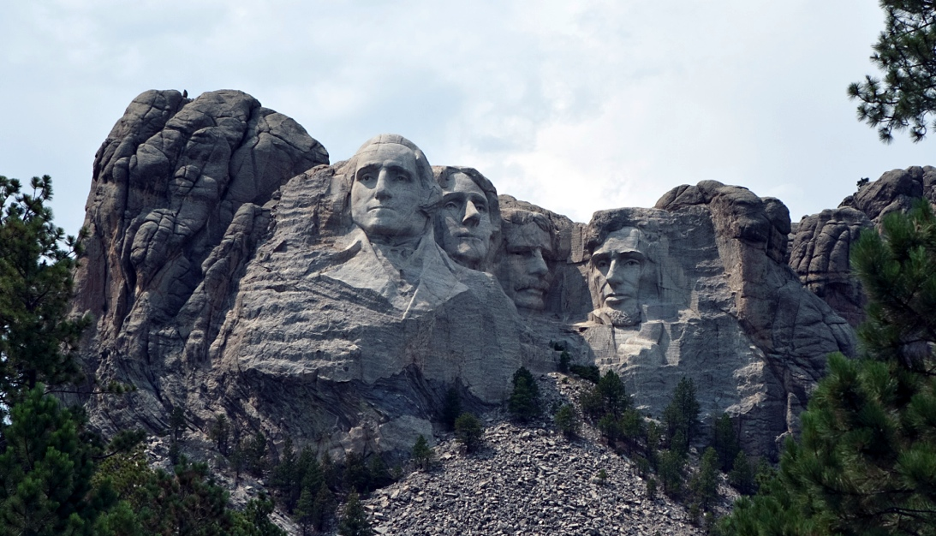
Some Background Information

Slide 7
Social, Economic & Political Preferences
Population study
Sample:
2,807 (2011)
Representative of the voting age population
Geographically representative
Gender (Male) | 44%
Age (Mean) | 45.64 Yrs
Income (Household) | $53,398
Home Mortgage or Owned | 54.97%
Single | 25.26%
Married or Widowed | 49.70%
Children (Number) | 1.2
US Citizen | 98.00%

Slide 8
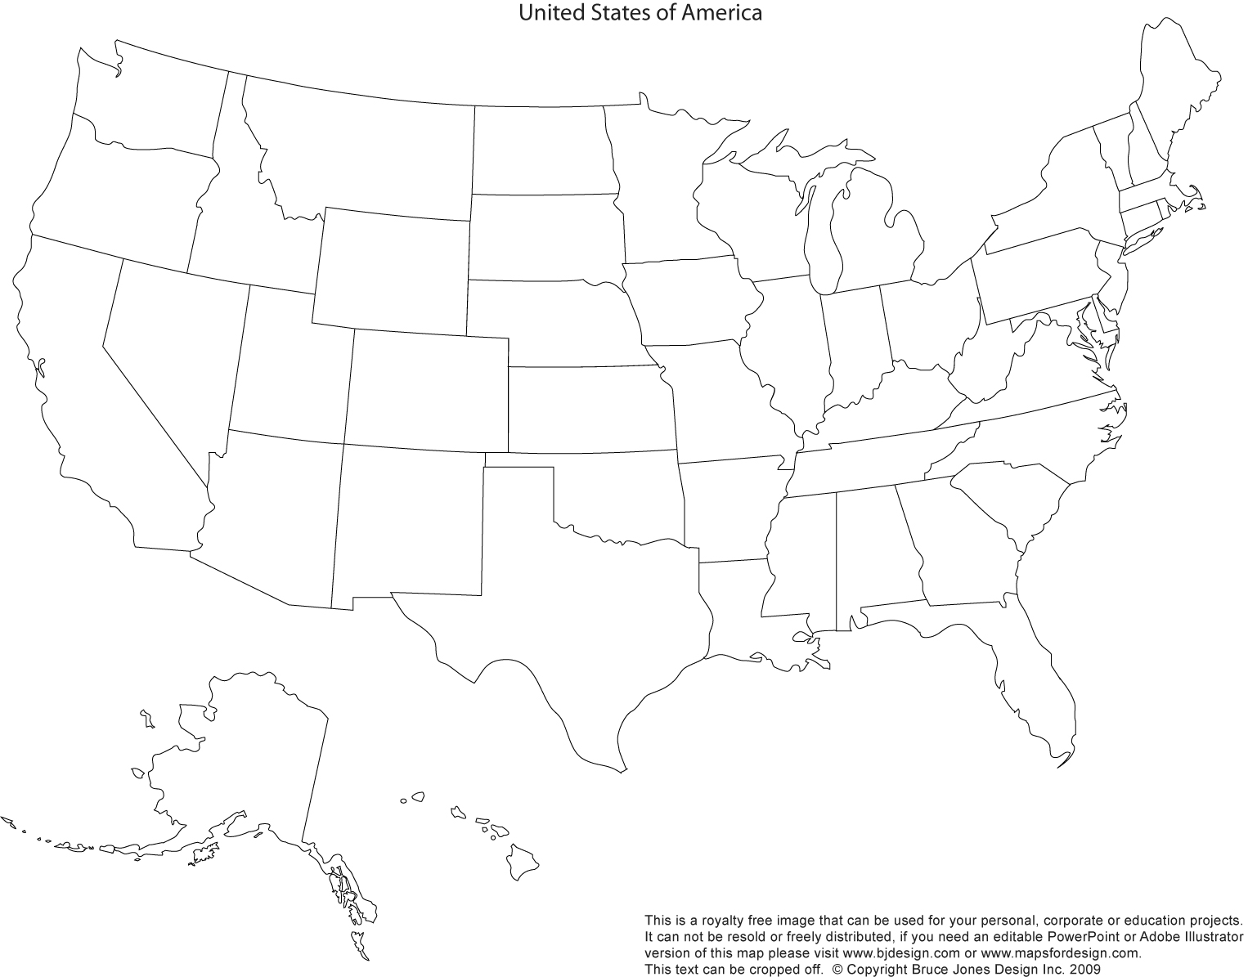
State/Region Representation
6.6
19.2
10.5
12.9
7.3
8.2
9.4
24.0
8.9
0.6
0.6

Slide 9
Politics and Life Satisfaction
Politics
Life Satisfaction

Slide 10
Religion
Religious Beliefs
Religion & Happiness

Slide 11
Religious Beliefs & Political Importance of Religion

Slide 12
Donating and Volunteering Behavior
Donating
Volunteering

Slide 13
Donating Activity
Average Annual Donation
Donating & Religion

Slide 14
Amount Donated (Given Donating to that Cause)

Slide 15
Level of Donation and Religiosity

Slide 16
Looking at Issue Categories

Slide 17
Social Preference Profiles (Categories)
General Categories | Selected Sub-Issues
Food and health | Water and sanitation, GM foods, obesity, abortion
Local crime and public safety | Safety, child pornography, violent crime, corruption
Rights to basic services | Healthcare, food, education, benefits of last resort
Civil and personal liberties | Rights: legal, to vote, marital, free speech etc.
Equality of opportunities | Discrimination based on age, gender etc.
Individual economic well-being | Inflation, taxation, interest rates, cost of living
Worker/employment rights | Work safety, unions, retirement, child labour
Environmental sustainability | Pollution, climate change, biodiversity loss
Societal economic well-being | Poverty, employment, energy prices, growth, deficit
Global security | Terrorism, nuclear weapons, criminal syndicates
Societal social well-being | Quality of schooling, public transport, immigration
Global economic well-being | Resources management, trade, global finance issues
Animal welfare | Treatment of individual animals and species' survival
Global social well-being | Peace, diseases, poverty
Minority rights | Rights including cultural preservation and expression
Commercial rights | Commerce and ownership such as IP rights

Slide 18
General Social Preference (Category)

Slide 19
International Category Comparisons
USA
Germany

Slide 20
International Category Comparisons
USA
UK

Slide 21
International Category Comparisons
USA
Australia

Slide 22
Adjusted International Differences

Slide 23
Some Salient Demographic Differences
Gender
Age (Correlation)

Slide 24
Some Salient Demographic Differences
Education
Income (Correlation)

Slide 25
Some Salient Socio-Demographic Differences
Religiosity
Happiness

Slide 26
Political Orientation
Republican v Democrat
Libertarian v Tea Party

Slide 27
Political Orientation
Republican v Independents
Democrat v Independent

Slide 28
Altruism, Donating & Volunteering
Machiavellianism
Donating & Volunteering

Slide 29
Some Micro Issues

Slide 30
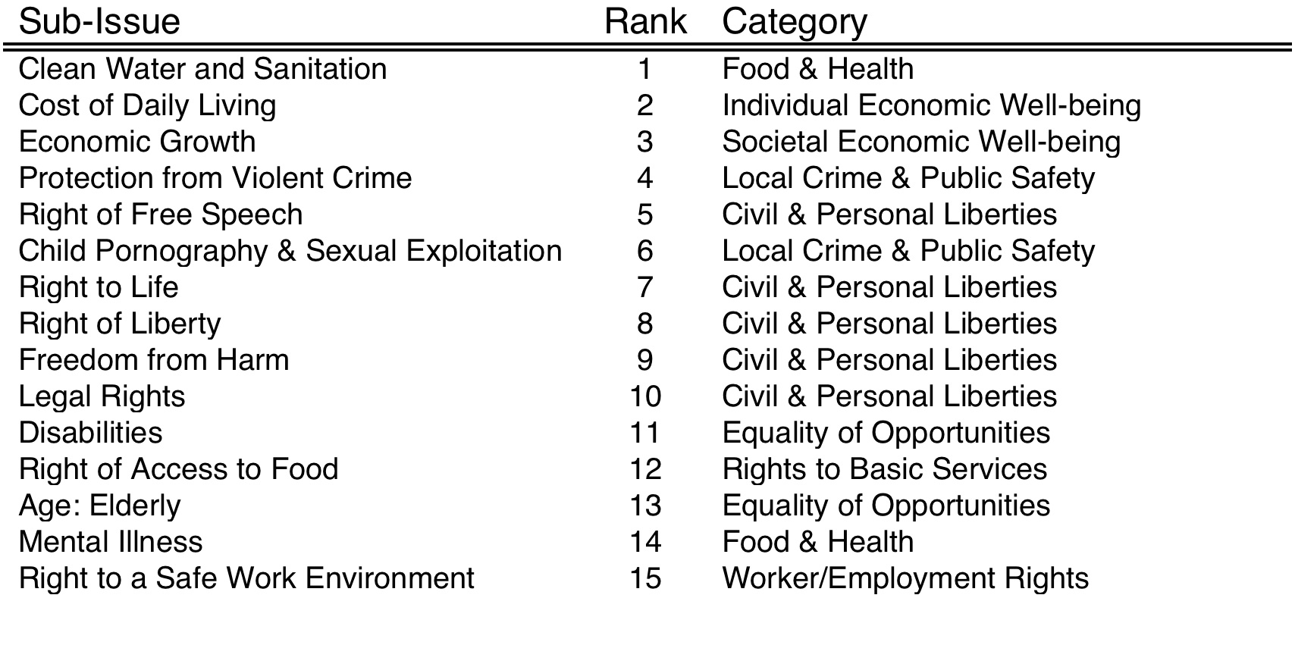
Looking at the Micro Issues
Individuals also were rotated through mixtures of 113 different social issues. This was done within categories and then between categories. This gives us two sets of measures for each person, allowing us to calibrate the validity of the measures

Slide 31
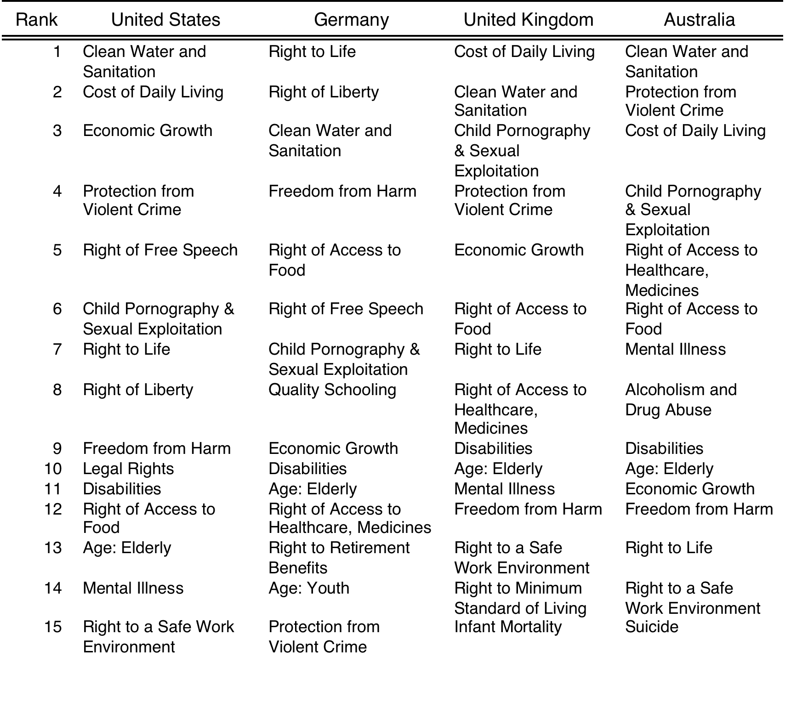
Internationally

Slide 32
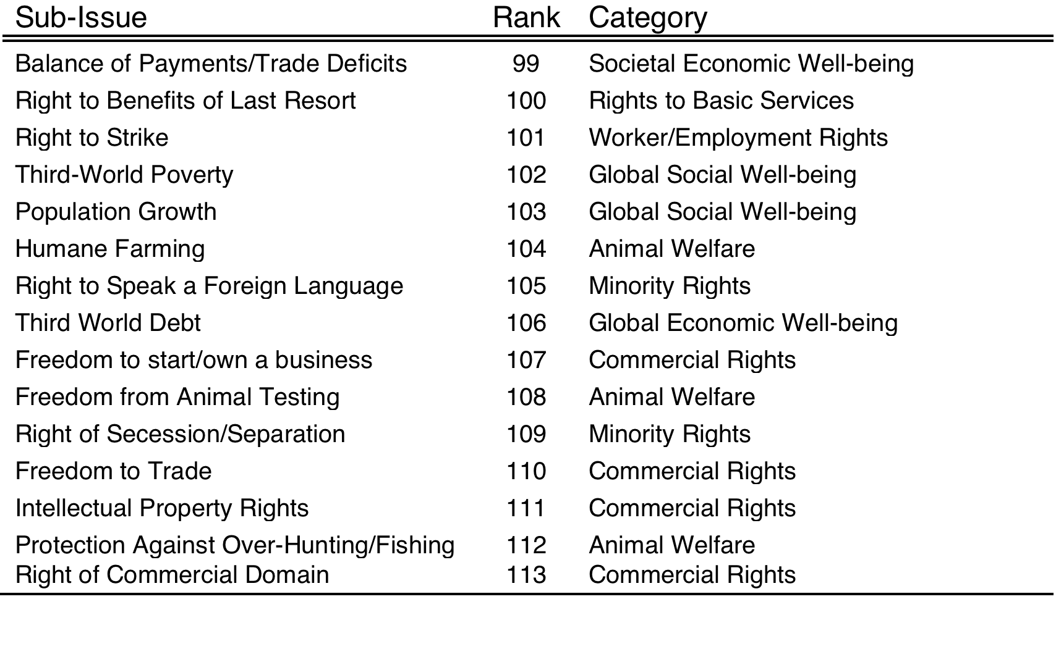
The Least Salient Issues

Slide 33
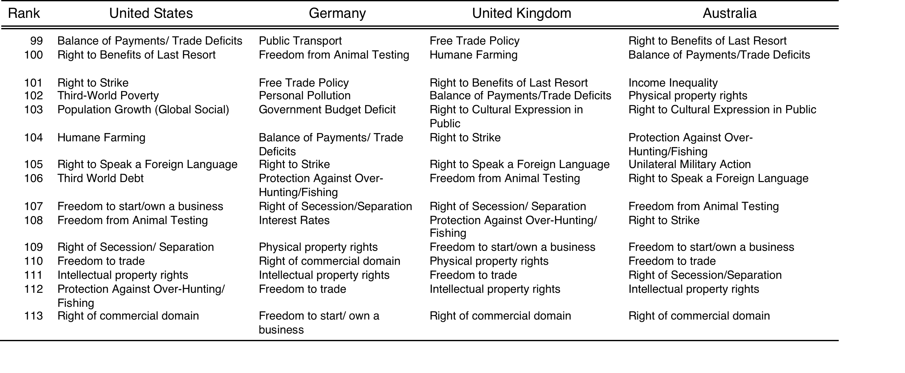
Internationally

Slide 34
Some Conclusions & Discussion

Slide 35
What Do We Conclude (About Americans)
Proximity matters
Individuals focus more intently on issues that are materially closer to what influences their lives
Attempts at “demographic” characterizations are fraught with problems
Except potentially at the extremes
However, looking at more revealing “socio-political” factors reveals insights
Religiosity: Individuals with strong religious beliefs reveal different preference patterns
Political Orientation: Individuals with extreme political views reveal different preference patterns
When it comes to CSO involvement the traditional stereotypes are unlikely to hold much validity

Slide 36
What Do We Conclude (More Globally)
The overall patterns seen in American are mirrored elsewhere
The major difference is related to religion/politics
Religiosity: Individuals with strong religious beliefs reveal different preference patterns (and there are more of these in America)
Political Orientation: Individuals with extreme political views reveal different preference patterns (and there are less of these in America)
Americans are less environmentally concerned and more likely to reveal a more individualistic and materialistic position relative to Australians, citizens of the UK, and Germans

Slide 37
How Might You Use What We are Doing?
Can you work with what people believe?
If NO
Can you live with a niche of ‘believers’?
Can you change everyone’s preferences? Or at least enough of them?
If YES
Understand the issues against which you are ‘competing’
Understand what issues can be reframed
Is there something fundamentally ‘incorrect’ in what people believe?
What are the mechanisms to ‘correct’ the error in belief?

Slide 38
Thank You
A Break & Then a Discussion

